Slide 1
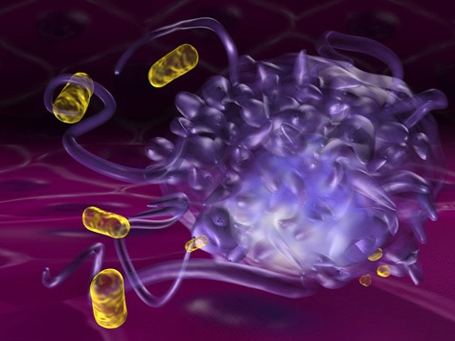

Mrs. Mamita Rai Gurung

Slide 2
General characteristics
Belongs to the genus Staphylococcus which includes over 30 species and subspecies.
S. aureus are Gram-positive cocci occurring in clusters.
Non motile, catalase-producing bacteria.
Coagulase positive hence carry medical importance.
Faculatative anaerobic or aerobic and the colonies appear as opaque, creamy or golden yellow.
They are also the normal flora of human and animals.

Slide 3
S. aureus causes:
Local purulent infection, bullous impetigo, wound infection, sinusitis, otitis media, mastitis puerperalis, otitis, postinfluenza pneumonia, sepsis, food intoxication, dermitis, toxic shock syndrome
Notes:
bullous impetigo:- large blister in area where skin folds

Slide 4
Antigenic structure
The cell wall of S. aureus consists of a typical Gram-positive peptidoglycan interspread with molecules of a ribitol-teichoic acid, which is antigenic and relatively specific for S. aureus.
In most strains, the peptidoglycan of the cell wall is overlaid with surface proteins; protein A, is unique in that it binds the Fc portion of IgG molecules, leaving the antigen-reacting Fab portion directed externally.
Some S aureus has capsule, which inhibit phagocytosis.

Slide 5
Enzymes and toxins
S aureus produces following enzymes and toxin that helps in thier pathogenicity:-
Catalase: produce catalase which converts H₂O₂ into water and oxygen.
Coagulase is an enzyme that clots oxalated or citrated plasma. It binds to prothrombin and activate the fibrin polymerization. Coagulase than deposite fibrin on surface of S aureus inhibit thier ingestion by phagocytic cells.
Other enzymes: Hyaluronidase, staphylokinase, proteinase, lipases, β-lactamase.

Slide 6
Hyaluronidase:- catalyse the degradation of hyaluronic acid (HA)
Staphylokinase:- It activates plasminogen to form plasmin, which digests fibrin clots, also cleaves IgG and complement component C3b, inhibiting phagocytosis.
Proteinase:- catalyzes (increases the rate of) proteolysis, the breakdown of proteins into smaller polypeptides or single amino acids.
Lipases:- that catalyzes the hydrolysis of fats (lipids)
β-lactamase:- provide multi-resistance to β-lactam antibiotics such as penicillins, cephalosporins, cephamycins,

Slide 7
Exotoxins:- produces
α- toxin is a potent hemolysin, that acts on broad spectrum of eukaryotic cell membrane.
Β- toxin degrades sphingomyelin so it is toxic for many kinds of cells including RBCs.
δ-toxins disrupts biological membranes and may have a role in diarrhoeal disease.
γ-toxins lyse WBCs.
Leukocidin
- Causes of lysis of WBCs by pore formation. It is an important virulence factor in community associated MRSA infection.

Slide 8
Exfoliative toxins
S aureus consists of 2 types of these toxin.
Epidermolytic toxin A :-heat stable and produced by chromosomal gene product).
Epidermolytic toxin B:- heat-labile and produced by plasmid)
These toxins cause scalded skin syndrome by dissolving mucopolysaccharide matrix of epidermis.
Toxic shock syndrome toxin
20% of S aureus produceToxic shock syndrome toxin-1(TSST-1)
The toxin is associated with fever, shock, and multisystem involvement, including a desquamative skin rash.

Slide 9
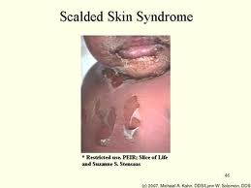

Slide 10
Enterotoxins
- There are multiple (A–E, G–I, K–M) enterotoxins.
Approximately 50% of S aureus strains can produce one
or more of them.
- They are superantigens and are heat-stable and
resistant to the action of gut enzymes.
- They cause food poisoining.

Slide 11
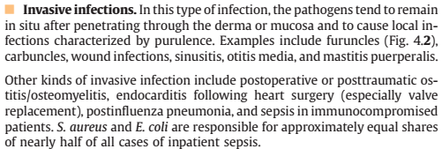
Pathogenicity of Staphylococcus aureus
The pathogenic capacity of a given strain of S aureus is the combined effect of extracellular factors and toxins together with the invasive properties of the strain.

Slide 12
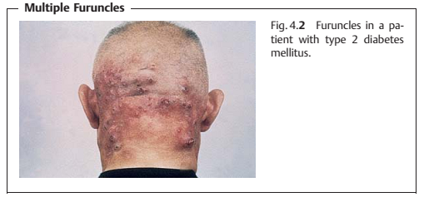


Slide 13
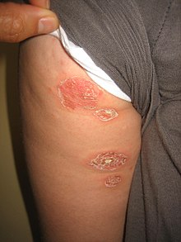
Bullous impetigo

Slide 14
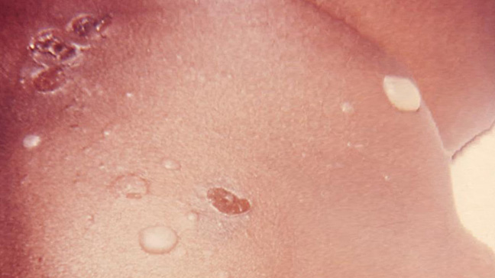

Slide 15
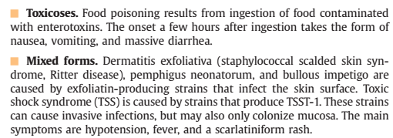

Slide 16
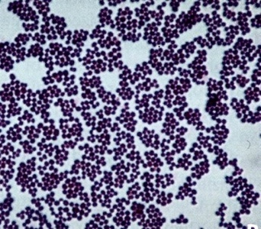
Lab diagnosis
Sample
Pus and sputum for culture and microscopy
Blood for culture
Faeces, vomit and food samples if food poisoining is suspected.

Slide 17
1.Microscopy:-Gram’s staining
Seen as gram positive cocci arranged usually in grape like clusters.
They are non motile and non capsulated.
2.Culture
Staphylococcus aureus can be grown on BA(blood agar), CA(chocolate agar), MA(Macconkey agar) and MSA(Mannitol salt agar).
Incubated at 37 degree celcius for 24 hrs.
In BA and CA, yellow to creamy colonies are seen. Some strains are B haemolytic. In MA, NLF(Non Lactose fermentor) colonies are seen.
In MSA, yellow colonies are seen.

Slide 18

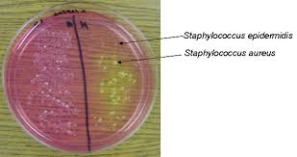
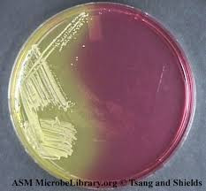

Slide 19
3. Biochemical test:
a.Catalase test
A drop of hydrogen peroxide solution is placed on a
slide, and a small amount of the bacterial growth is
placed in the solution. The formation of bubbles (the
release of oxygen) indicates a positive test.
b.Coagulase test
In a glass slide drop of plasma added in which S. aureus culture is added and clotting of plasma indictes the positive(Coagulative positive strains are pathogenic to human).

Slide 20
4.DNase test
Stphylococcus aureus is DNase positive whereas others are DNase negative.
DNA Hydrolysis test or Deoxyribonuclease (DNase) test is used to determine the ability of an organism to hydrolyze DNA and utilize it as a source of carbon and energy for growth.
5.Serologic and typing test
Little practical value.
Pulsed field gel electrophoresis and multilocus sequence typing are done.

Slide 21
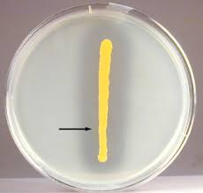
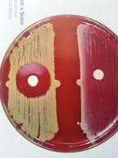

Slide 22
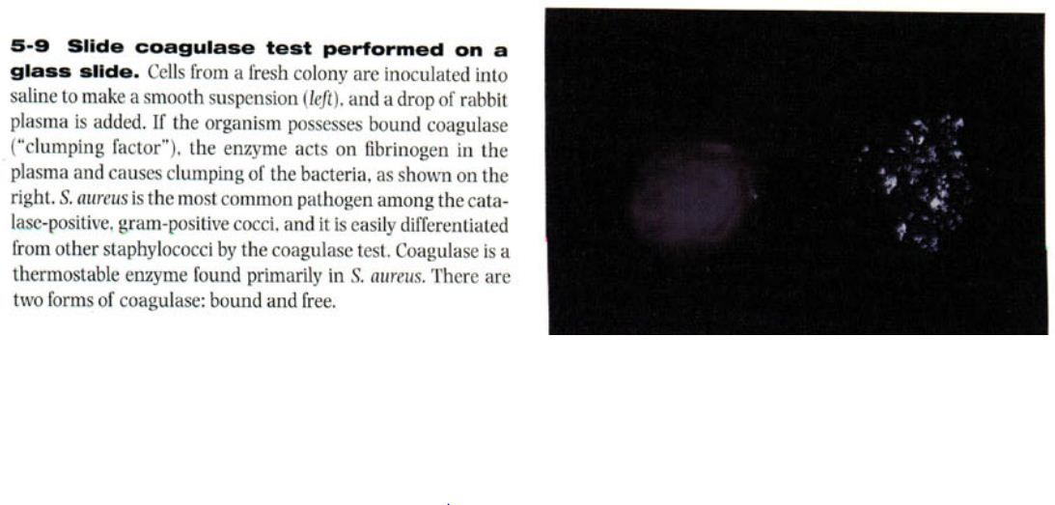

Slide 23
Treatment
Tetracycllin,penicillin, Vancomycin, nafcillin etc

